Slide 1
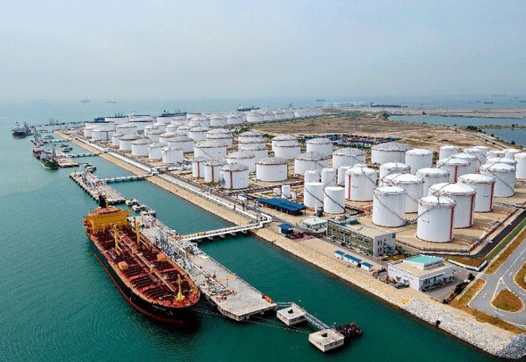
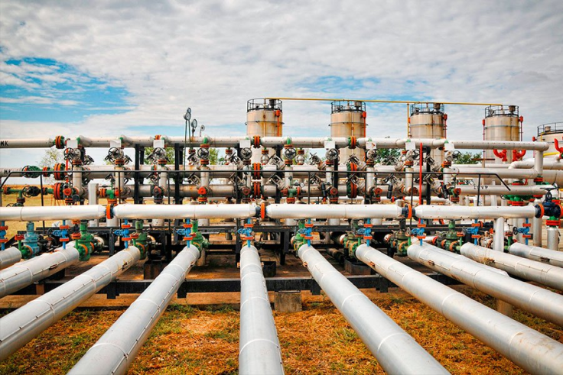
Optimization of Manifold Route in Oil/Chemical Terminals
Oil/Chemical Terminal is an industrial facility for the storage of oil and/or petrochemical products and from which these products are usually transported to end users or further storage facilities.
Modern large terminals usually handle multiple different products, from crude oil, gasoline, diesel to wide range of petrochemical derivatives. Hence manifolds are used extensively throughout the terminal for the distribution of gases and fluids. They are designed to converge multiple junctions into a single channel or diverge a single channel into multiple junctions according to the planning.
The loading/offloading time between tanker ship and tank storage farms is one of the most important KPI in terminal operation. Reduced docking time of tanker ships will result in significant economic savings.

Slide 2
Optimization of Manifold Route in Oil/Chemical Terminals
Objective Function
Minimize the total transfer time and waiting time (time at departure of ship – time at arrival of ship) of all tanker ships in one day
Assumptions:
The terminal only stores single product which is crude oil.
The product transferring time = Ship Capacity/Pump Capacity. Length of pipeline is ignored. The transferring time will be in 15 mins block.
One or multiple pumps can be selected for the same transfer.
Each pipe section can only be used for 1 transfer operation at a time. Pipe sharing for different operations is not allowed
Products from multiple customers can be stored in a single tank so long as capacity allows

Slide 3
Optimization of Manifold Route in Oil/Chemical Terminals
Decision Variable
Pumps Selected for Transfer in each 15 mins block ^{Note1}
Valves Selected for Transfer in each 15 mins block ^{Note1}
Tank Selected for Transfer in each 15 mins block
Ships Selected for Transfer in each 15 mins block
Jetty Selected for Transfer in each 15 mins block
Note 1: The pump selection and valve selection might be transformed to a single decision variable: pipe section selection.

Slide 4
Optimization of Manifold Route in Oil/Chemical Terminals
Constraints:
Availability of Pumps (Both operation reservation and maintenance reservation)
Availability of Valves (Both operation reservation and maintenance reservation)
Availability of Jetty (Both operation reservation and maintenance reservation)
Pump cannot operate beyond capacity
Tank capacity
A particular pipe section (or valve and pumps) can only be used for 1 transfer operation at a time.
The operation start time cannot be earlier than ship arrival time

Slide 5
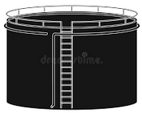

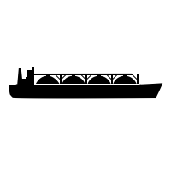

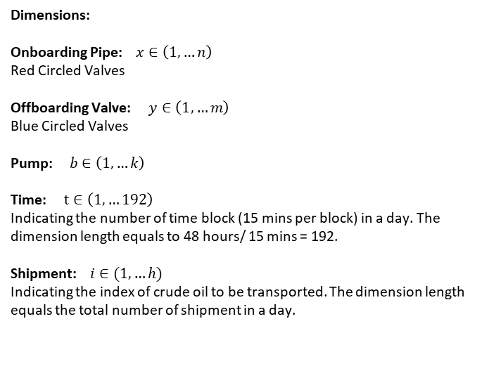
Tank Farms
Crude Tank 1
Jetty 1
Jetty 2
Crude Tank 2
Crude Tank 3
Dimensions:
Onboarding Pipe: $x∈\left(1,…n\right)$ Red Circled Valves
Offboarding Valve: $y∈\left(1,…m\right)$ Blue Circled Valves
Pump: $b∈\left(1,…k\right)$
Time: $t∈\left(1,…192\right)$ Indicating the number of time block (15 mins per block) in a day. The dimension length equals to 48 hours/ 15 mins = 192.
Shipment: $i∈(1,…h)$ Indicating the index of crude oil to be transported. The dimension length equals the total number of shipment in a day.
Pumps
Valves

Slide 6
Tank Farms
Crude Tank 1
Jetty 1
Jetty 2
Crude Tank 2
Crude Tank 3
Pumps
Decision Variable:
Von _{x, b, t, i} : The on-boarding valve is engaged for transfer of shipment i at time section t.
Voff _{y, b, t, i} : The off-boarding valve is engaged for transfer of shipment i at time section t.
P_{b,t,i} : The pump b is engaged for transfer of shipment i at time section t.
SD_{x, t, i} : The ship for shipment i docked at the jetty x at time t (production transfer in progress)
SW_{t, i} : The ship for shipment i waiting at the terminal at time t
Valves

Slide 7
Tank Farms
Crude Tank 1
Jetty 1
Jetty 2
Crude Tank 2
Crude Tank 3
Parameters
AT_{i} : The ship arrival time of shipment k
Vol_{i} : The shipment volume to be transferred from jetty to tank (ship to tank)
VA_{x,y, t} : On boarding valve availability. 0 = Valve (x,y) is unavailable at the time block t due to maintenance shutdown
VA_{b,y, t} : Off boarding valve availability. 0 = Valve (b,y) is unavailable at the time block t due to maintenance shutdown
PA_{b,t} : Pump availability. 0 = Pump b is unavailable at time block t due to maintenance shutdown
JA_{x,t} : Jetty availability. 0 = Jetty x is unavailable at time block t due to maintenance shutdown
PC_{b} : The Pump capacity
Pumps
Valves

Slide 8

Tank Farms
Crude Tank 1
Jetty 1
Jetty 2
Crude Tank 2
Crude Tank 3
Intermediate Variables
Unit Transfer Volume for each shipment :
$$UTV_{k}= \sum_{1}^{t}{\sum_{1}^{n}{P_{n,t,k}∗PC_{n}}}$$
Transfer time for each shipment :
$TT_{k}=$ $\frac{VST_{k}}{UTV_{k}}$
Objective Function
Minimize total turn around time of all ships:
$$Min \sum_{1}^{h}{\sum_{1}^{192}{(\sum_{1}^{n}{SD_{x, t, i}}+SW_{t, i})}}$$
Pumps
Valves

Slide 9
Tank Farms
Crude Tank 1
Jetty 1
Jetty 2
Crude Tank 2
Crude Tank 3
Constraints
ST_{k,t} : The shipment to be transferred from jetty to tank (ship to tank), with ship arrival time at t
TS_{k,t} : The shipment to be transfer from tank to jetty (tank to ship), with ship arrival time at t
V_{mt} : Valve availability. 0 = Valve m is unavailable at the time block t due to maintenance shutdown
P_{nt} : Pump availability. 0 = Pump n is unavailable at time block t due to maintenance shutdown
J_{lt} : Jetty availability. 0 = Jetty l is unavailable at time block t due to maintenance shutdown
Pumps
Valves

Slide 10
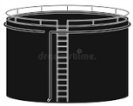
Tank Farms
Crude Tank 1
Jetty 1
Jetty 2
Crude Tank 2
Crude Tank 3
Pumps
Crude Tank 4
Valves
Crude Tank 5
Jetty 3
Jetty 4
Crude Tank 6
Crude Tank 7

